Slide 1
DAYS OF THE WEEK

Slide 2
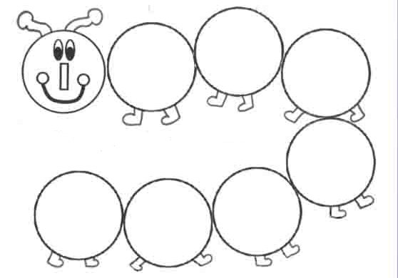
DAYS OF THE WEEK

Slide 3
What’s your favourite day?
My favourite day is__________.

Slide 4
What day is it today?
Today is___________.

Slide 5
What day was it yesterday?
Yesterday was___________.

Slide 6
What day will it be tomorrow?
Tomorrow will be____________.

